Slide 1




SOLAR PANEL POWER GENERATION PREDICTION
Regression Model for Power Prediction

Slide 2


PROBLEM STATEMENT
Difficulty in predicting solar panel power generation due to varying weather conditions.
Uncertainty
Need for accurate forecasting to improve efficiency of solar energy usage.
Efficiency

Slide 3


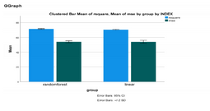
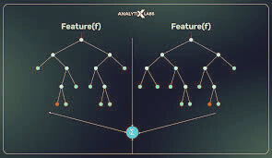
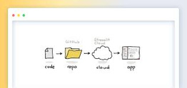

OBJECTIVE
Analysis
Comparision
Analyze solar energy & weather dataset
Compare multiple models & select the best
Modeling
Deployment
Build regression model to predict power generation
Deploy model with for real-time usage

Slide 4
DATASET DESCRIPTION
Source
Provided Dataset (CSV)
Size
Total Rows: 2920, Columns:10
Target Variable
Power Generated
Time-based : “distance-to-solar-noon”
Feature Categories
Weather-based : All other features
Natures of Data
Combination of numerical & continuous values

Slide 5
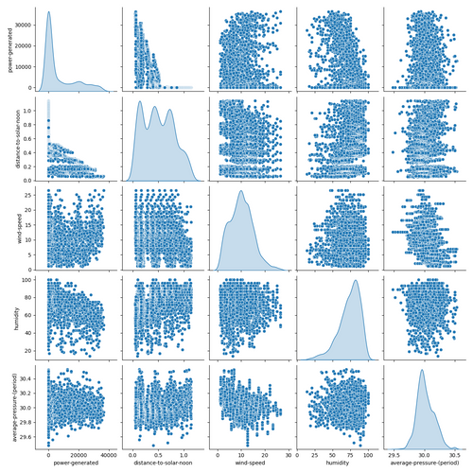

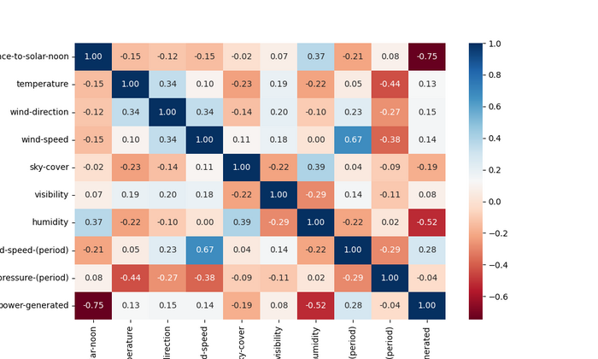

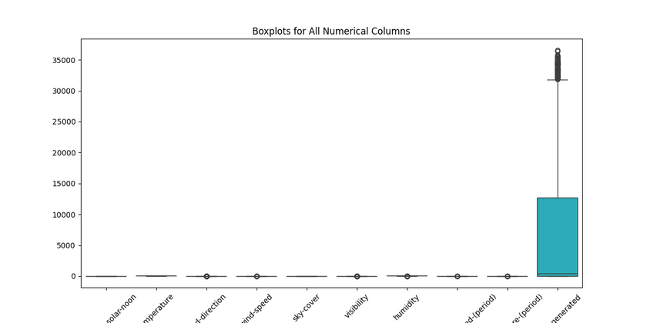

EXPLORATORY DATA ANALYSIS
Studied feature distributions & relationships
Observed correlation of weather factors with solar power
Detected outliers and variations using boxplots
Insights guided feature selection & preprocessing

Slide 6


DATA PREPROCESSING
Handling Missing values
Feature Selection
Train-Test Split
Scaling / Transformation

Slide 7
DATA CHALLENGE
Issue
Target feature (power-generated) had many zero values
Risk
Could mislead the regression model
Split dataset → Zero values vs Valid values → Trained regression model on Valid values to predict & refine Zero values.
Action
Result
Improved data quality & reliable model performance.

Slide 8

MODEL BUILDING
Linear Regression
Random Forest Regressor
Ridge Regression
XGBoost
Best performing :
Random Forest Regressor

Slide 9




PIPELINE
Why Pipeline?
Ensures consistent data transformations
Reduces manual errors
Makes deployment smoother
Simplifies reproducibility of results
Steps in Pipeline
Data Preprocessing (handling missing & zero values)
Feature Scaling & Encoding
Model Training (Regression)

Slide 10

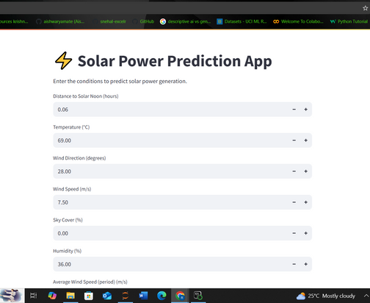

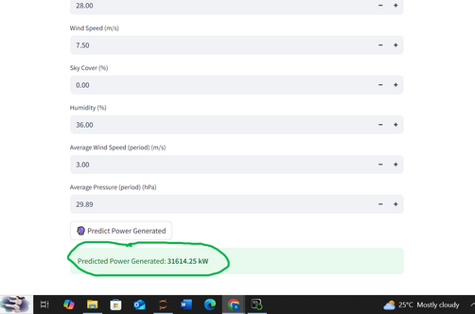
DEPLOYMENT
-Built Streamlit app (app.py)
- Inputs: weather & environment features
- Output: Predicted power generated (kW)

Slide 11
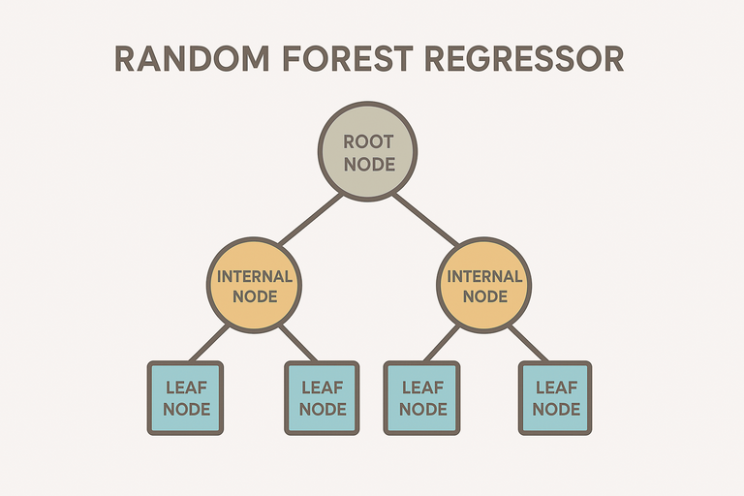



RESULT
Best Model :
Random Forest Regressor
•R² Score: 94.15%
Streamlit app successfully predicts power generation

Slide 12

CONCLUSION
- Solar energy prediction improves energy planning
- Random Forest most reliable model for dataset

Slide 13
THANK YOU

